Slide 1
Response Termination Criteria
CGPRT(W) : Ensuring Clean Seas and Coasts in Western Region ……

Slide 2
Objective
To understand the issues related to response termination.
To understand the selection and definition of termination criteria.
CGPRT(W) : Ensuring Clean Seas and Coasts in Western Region ……

Slide 3
Termination of Response
Termination of response is one of the most delicate stages of oil spill response
  Difficulty to reach agreement on completion of clean-up
    At sea, shoreline
  Competing interests
    Environmental
    Technical
    Economic
    Political
CGPRT(W) : Ensuring Clean Seas and Coasts in Western Region ……

Slide 4
Termination of Response
Typical questions during a response:
  If dispersants are being used, when should their application be terminated?
  At what point is it appropriate to demobilize recovery vessels?
  Is further clean-up of sandy beaches necessary?
In initial stages when a significant quantity of oil is present these decisions are easy to make
When oil quantities on water or shoreline are diminishing the decision is not as easily determined
CGPRT(W) : Ensuring Clean Seas and Coasts in Western Region ……

Slide 5
Law of Diminishing Returns
Oil plentiful in the early stages:
  high volume of oil treatment
As clean-up brought to a close:
  very little oil remains
At some point the costs of oil treatment are disproportionate to the benefits
Oil Treated
Clean-up Effort
CGPRT(W) : Ensuring Clean Seas and Coasts in Western Region ……

Slide 6
Termination of Response
Objectives of response must be clearly established, if at all possible, before a spill even occurs, as part of the planning process
  Agreement between stakeholders
    Government
    Potential responsible parties including ship/facility owners
    Other key stakeholders such as landowners
  Set termination criteria
When these objectives are reached, response should end
CGPRT(W) : Ensuring Clean Seas and Coasts in Western Region ……

Slide 7
Termination of Response
Overall objectives:
  At sea
    Attempt to treat oil to minimize pollution damages
  On shore
    Restore the use or value of the polluted area whilst minimizing further pollution damages
Need for specific termination criteria
How clean is clean?
CGPRT(W) : Ensuring Clean Seas and Coasts in Western Region ……

Slide 8
How Clean is “Clean”?
Definition of “clean” – must be agreed upon by key stakeholders and should be for specific areas and/or circumstances.
Considerations include:
  Natural processes and timescale
  Effectiveness of clean-up methods
  Socio-economic considerations
  Archaeological and cultural considerations
  Environmental benefits
  Perception of public and the media
  Consensus decision-making
CGPRT(W) : Ensuring Clean Seas and Coasts in Western Region ……

Slide 9
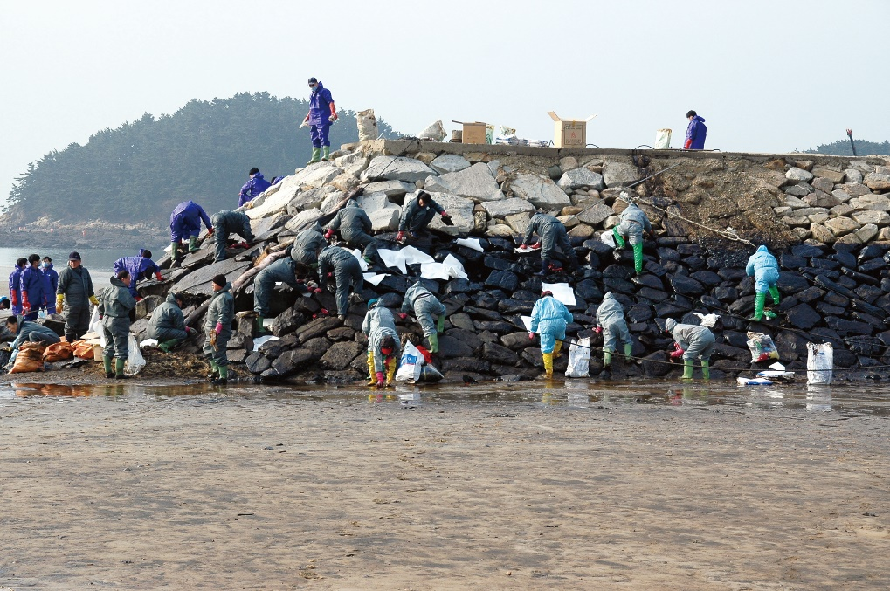
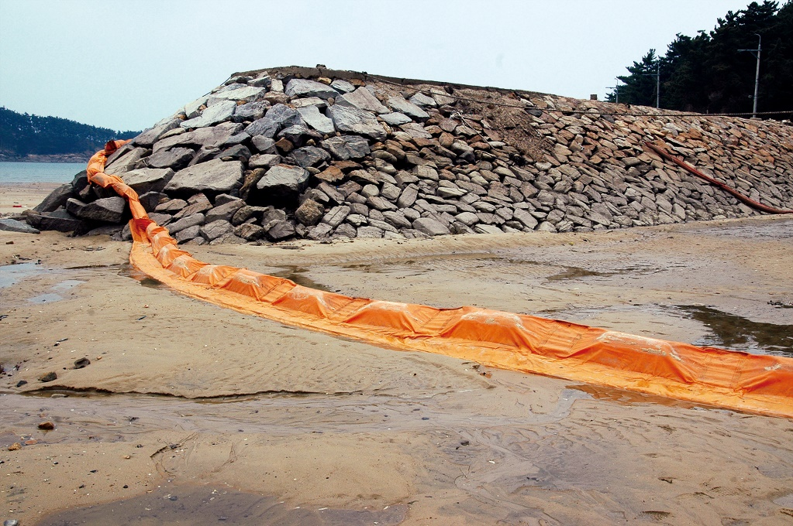
How Clean is “Clean”?
CGPRT(W) : Ensuring Clean Seas and Coasts in Western Region ……

Slide 10
Termination Considerations
At-sea clean-up:
  Measures no longer effective
  Further clean-up is likely to cause greater damage
  Safety issues
  Level of response is out of proportion to the amount of oil on the water
  When the costs of the response are exceeding the likely benefits
CGPRT(W) : Ensuring Clean Seas and Coasts in Western Region ……

Slide 11
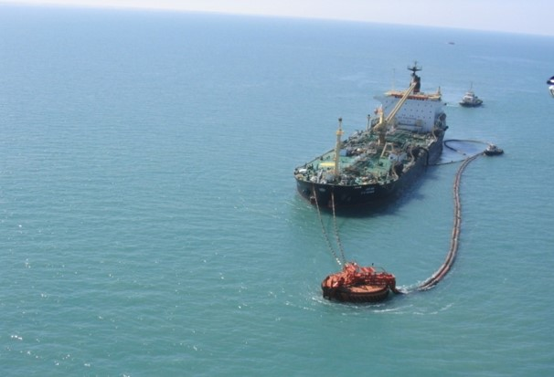
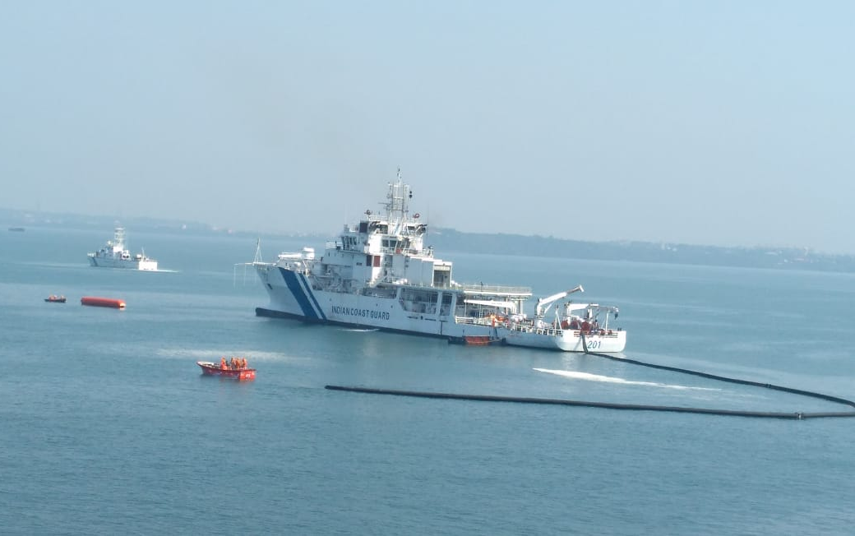
Termination Considerations
CGPRT(W) : Ensuring Clean Seas and Coasts in Western Region ……

Slide 12
Termination Considerations
Shoreline clean-up
  Commitments agreed with authorities (in contingency plan) have been satisfied
  Further clean-up is likely to cause greater damage
  Point of diminishing returns is reached
  When cost of clean-up is out of proportion to area’s importance
  When economic loss caused by non-use of areas being cleaned exceeds any benefits
CGPRT(W) : Ensuring Clean Seas and Coasts in Western Region ……

Slide 13
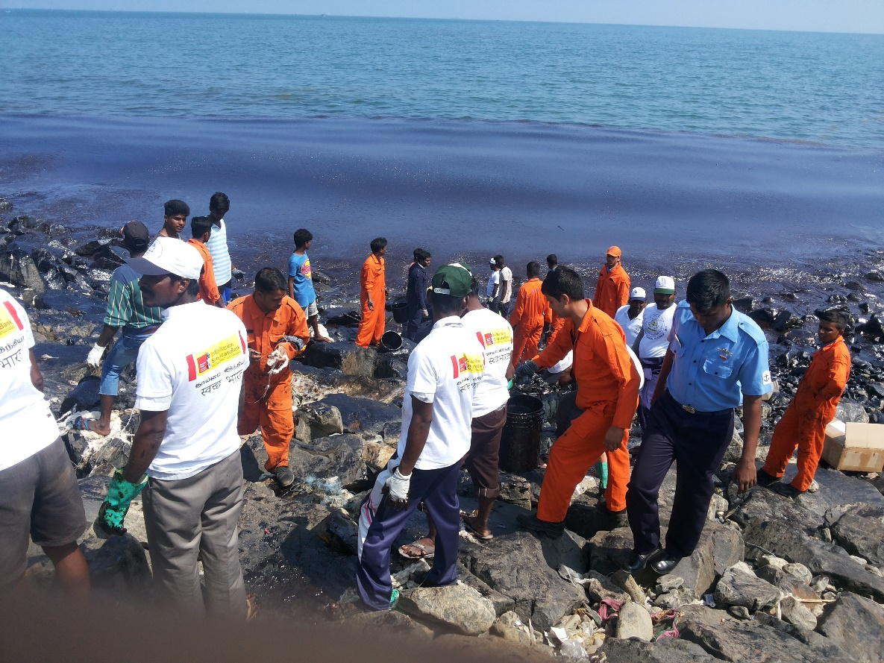
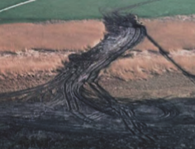
Termination Considerations
CGPRT(W) : Ensuring Clean Seas and Coasts in Western Region ……

Slide 14
Example of Termination Criteria
Resource
Criteria
Food and water (for human consumption)
Statutory specifications and taste tests
Amenity beaches and structures
No visible oil and no oil sticking to people or boats
Water surface (used by birds, mammals)
No visible oil or sheen that might adhere to feathers or fur
CGPRT(W) : Ensuring Clean Seas and Coasts in Western Region ……

Slide 15
Example of Termination Criteria
Resource
Criteria
Subsurface water (habitat for fish, corals, sea grass, etc.)
Concentration at background levels. Must not be toxic to key species
Shoreline (habitat for algae, mangroves, molluscs, etc.)
Need not be visibly clean but residues must not inhibit recovery by smothering or toxicity
Shoreline (ecosystem interacting with other near-shore systems)
Residues must not be mobile to leach to other near-shore areas
CGPRT(W) : Ensuring Clean Seas and Coasts in Western Region ……

Slide 16
Conclusion
Termination of response is often a contentious issue.
Clear response objectives and end-points criteria must be established at the beginning of a spill in a collaborative manner.
Decision-makers must be aware of response termination criteria at the beginning of an incident and adjust operations accordingly.
CGPRT(W) : Ensuring Clean Seas and Coasts in Western Region ……

Slide 17
Any questions?
CGPRT(W) : Ensuring Clean Seas and Coasts in Western Region ……

